Slide 1
Tactical & Strategic AI
GAM 376

Slide 2
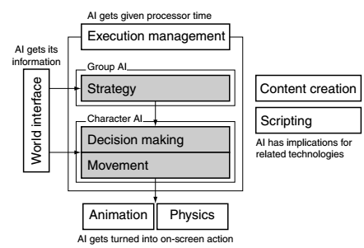
Tactical & Strategic AI
Current AI Model

Slide 3
Waypoint Tactics
Waypoint
Single Position in Game Level
Can think of them as nodes in pathfinding
Instead of just a node with a position it is layered with tactical information set by the game designer

Slide 4
Tactical Locations
Also known as “rally points”
Common Types
Defensive Locations
Buildings, Camps
Cover Points
Walls, barrels, sand bags.
Level designers can mark locations suitable for snipers or locations with intense shadows to set up ambushes.

Slide 5
Set of Locations
Levels will usually contain a large set tactical qualities.
If they are used for pathfinding
They will also contain pathfinding data
Neighboring nodes & edges
Lets look at an example

Slide 6
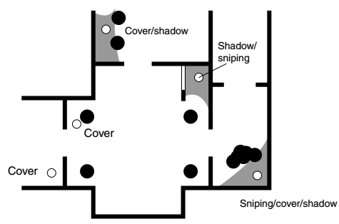
Example

Slide 7
Primitive & Compound Tactics
We don’t have to be create static data for the characters but allow the characters to calculate and decide what they believe is a good waypoint.
Example
Cover and view of the enemy
Dynamic data

Slide 8
Primitive & Compound Tactics
We don’t need to limit a single location to both properties
Example
Character is near a cover and fire point
Character could duck into cover reload and move to a nearby fire point.
Character could look for exposed locations with nearby hiding behaviors.
Compounding waypoints data to pick a series of waypoints to use

Slide 9
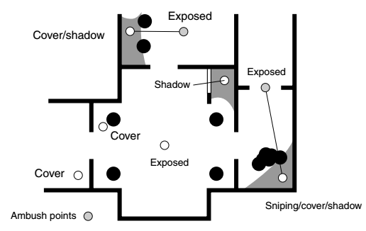
Example

Slide 10
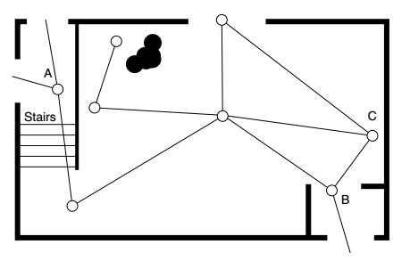
Pathfinding & Waypoints

Slide 11
Continuous Tactics
We don’t have to have simple Boolean values to describing waypoint data
Provide numeric values for each point
i.e. Cover & Shadow
Further you can apply fuzzy logic to these points.
Each point has a degree of membership for Cover and Shadow

Slide 12
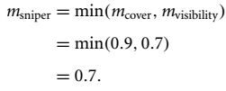
Continuous Tactics
Fuzzy Logic Example
Sniper location contains a DOM for cover and shadow
Fuzzy Rule:
Assume Cover = 0.9 and Visibility = 0.7

Slide 13
Continuous Tactics
Disadvantage of this approach is keeping track and process all this data.
Further if the data is dynamic it could potentially be costly
Plus side it would give us smarter data for the character’s to act upon.

Slide 14
Context Sensitivity
Potential Problem
Locations could be sensitive to the state of the game or current character actions
Example
Barrel can only provide cover if you crouch behind it.
Simplest solution
Keep more data at each waypoint for the character to use.
Second approach
Each waypoint holds one state and when character checks this waypoint it evaluates whether or not its appropriate.

Slide 15
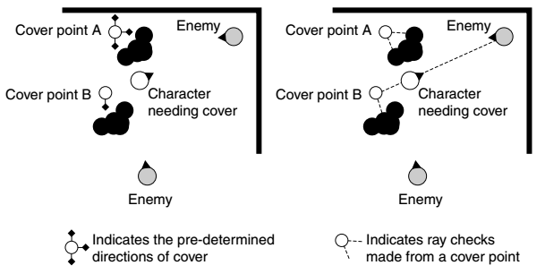
Context Sensitivity

Slide 16
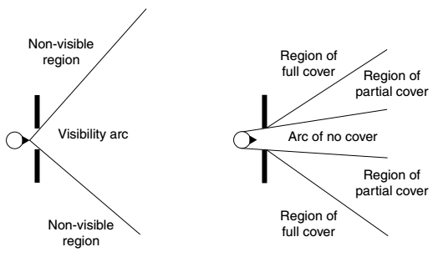
Visibility Points

Slide 17
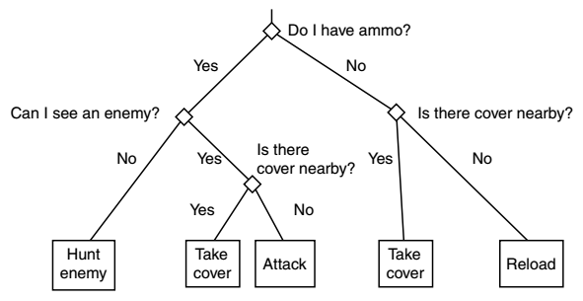
Decision Making
You can incorporate the waypoints into decision making.

Slide 18
In Zombie Game

